Slide 1
Graphs
CSE 3318– Algorithms and Data Structures
Alexandra Stefan
University of Texas at Arlington

Slide 2
References and Recommended Review
Recommended Student Review
from CSE 2315
Representation
Adjacency matrix
Adjacency lists
Concepts:
vertex, edge, path, cycle, connected.
Search:
Breadth-first
Depth-first
Recommended: CLRS
Graph definition and representations
CLRS (3rd edition) - Chapter 22.1 (pg 589)
Sedgewick - Ch 3.7 (pg 120)
115-120: 2D arrays and lists
Graph traversal
CLRS: BFS - 22.2, DFS-22.3
Sedgewick, Ch 5.8
The code used in slides is from Sedgewick.
See other links on the Code page.

Slide 3
Graphs
Graphs are representations of structures, set relations, and states and state-transitions.
Direct representation of a real-world structures
Networks (roads, computers, social)
States and state transitions of a problem.
Game-playing algorithms (e.g., Rubik’s cube).
Problem-solving algorithms (e.g., for automated proofs).
Often times in these cases you do not have the entire graph. You build it as you go (based on the moves played in the game)
A graph is defined as G = (V,E) where:
V : set of vertices (or nodes).
E : set of edges.
Each edge is a pair of two vertices in V: e = (v₁,v₂).
0
6
2
1
7
3
5
4

Slide 4
Graphs
G = (V,E)
How many graphs are here?: 1
|V| = 8 , V: { 0, 1, 2, 3, 4, 5, 6, 7 }
|E| = 7 , E: { (0,2), (0,6), (0, 7), (3, 4), (3, 5), (4, 5), (6,7)}.
Paths
Are 2 and 7 connected? Yes: paths 2-0-6-7 or 2-0-7
Are 1 and 3 connected? No.
Cycle
A path from a node back to itself.
Any cycles here? 3-5-4-3, 0-6-7-0
Directed / undirected
Connected component (in undirected graphs)
A set of vertices s.t. for any two vertices, u and v, there is a path from u to v.
Here: Maximal: {1}, {3,4,5}, {2,0,6,7}. Non-maximal {0,6,7}, {3,5},…
In directed graphs: strongly connected components.
Degree of a vertex
Number of edges incident to the vertex (for undirected graphs).
Here: degree(0) = 3, degree(1) = 0 , degree(5) = 2
Sparse /dense
Representation: adjacency matrix, adjacency list
undirected graph
0
6
2
1
7
3
5
4
Note: A tree is a graph that is connected and has no cycles

Slide 5
Directed vs Undirected Graphs
Graphs can be directed or undirected.
Undirected graph: edges have no direction
edge (A, B) means that we can go (on that edge) from both A to B and B to A.
Directed graph: edges have direction
edge (A, B) means that we can go (on that edge) from A to B, but not from B to A.
will have both edge (A, B) and edge (B, A) if A and B are linked in both directions.
directed graph
0
6
2
1
7
3
5
4
Degree of a vertex of a directed graph:
In-degree – number of edges arriving at this vertex
Out-degree – number of edges leaving from this vertex
Vertex | 0 | 4 | 5 | 1 | 7
In degree
Out-degree

Slide 6
Directed vs Undirected Graphs
Graphs can be directed or undirected.
Undirected graph: edges have no direction
edge (A, B) means that we can go (on that edge) from both A to B and B to A.
Directed graph: edges have direction
edge (A, B) means that we can go (on that edge) from A to B, but not from B to A.
will have both edge (A, B) and edge (B, A) if A and B are linked in both directions.
directed graph
0
6
2
1
7
3
5
4
Degree of a vertex of a directed graph:
In-degree – number of edges arriving at this vertex
Out-degree – number of edges leaving from this vertex
Vertex | 0 | 4 | 5 | 1 | 7
In degree | 2 | 2 | 0 | 0 | 1
Out-degree | 2 | 0 | 2 | 0 | 1

Slide 7
Strongly Connected Components (Directed Graphs)
Graph
How many “connected components” does this graph have?
Can you get from 0 to every other vertex?
Can you get from 3 to 6?
For directed graphs we define strongly connected components: a subset of vertices, V_{s}, and the edges between them , E_{s}, such that for any two vertices u,v in V_{s} we can get from u to v (and from v to u) with only edges from E_{s}.
Strongly connected components in this graph:
{0,1,4,5}, {0,4}, {1,5,4}, {0,5,4}
NOT strongly connected components.
{6,2,3}, {0,1} Why?
0
1
2
3
4
5
6
Strongly connected components:
0
1
0
4
5
4
1
0
4
5
4
5
NOT strongly connected
0
1

Slide 8
Graph Representations
G = (V,E). Let |V| = N and |E| = M.
|V| is the size of set V, i.e. number of vertices in the graph. Similar for |E|.
Notation abuse: V (and E) instead of |V| (and |E|).
Vertices: store N
E.g.: If graph G has N=8 vertices, those vertices will be: 0, 1, 2, 3, 4, 5, 6, 7.
Excludes case where additional labels are needed for vertices (e.g. city names).
Edges: 2 representations:
Adjacency matrix:
A is a 2D matrix of size VxV
Adjacency lists:
A is a 1D array of V linked lists
 | 0 | 1 | 2 | 3 | 4 | 5 | 6 | 7
0 | 0 | 1 | 1 | 0 | 0 | 1 | 1 | 1
1 | 1 | 0 | 0 | 0 | 0 | 0 | 0 | 0
2 | 1 | 0 | 0 | 0 | 0 | 0 | 0 | 0
3 | 0 | 0 | 0 | 0 | 1 | 1 | 0 | 0
4 | 0 | 0 | 0 | 1 | 0 | 1 | 1 | 1
5 | 1 | 0 | 0 | 1 | 1 | 0 | 0 | 0
6 | 1 | 0 | 0 | 0 | 1 | 0 | 0 | 0
7 | 1 | 0 | 0 | 0 | 1 | 0 | 0 | 0
A
2
3
1
0
3
2
0
1
0
1

Slide 9
Adjacency Matrix
- Space complexity: Θ(V²)
- Time complexity for add/remove/check edge: Θ(1)
- Time complexity to find neighbors: Θ(V)
V vertices labelled: 0,1, . . . , V-1.
Represent edges using a 2D matrix, M, of size V*V.
M[x][y] = 1 if and only if there is an edge from x to y.
M[x][y] = 0 otherwise (there is no edge from x to y).
 | 0 | 1 | 2 | 3 | 4 | 5 | 6 | 7
0 | 0 | 1 | 1 | 0 | 0 | 1 | 1 | 1
1 | 1 | 0 | 0 | 0 | 0 | 0 | 0 | 0
2 | 1 | 0 | 0 | 0 | 0 | 0 | 0 | 0
3 | 0 | 0 | 0 | 0 | 1 | 1 | 0 | 0
4 | 0 | 0 | 0 | 1 | 0 | 1 | 1 | 1
5 | 1 | 0 | 0 | 1 | 1 | 0 | 0 | 0
6 | 1 | 0 | 0 | 0 | 1 | 0 | 0 | 0
7 | 1 | 0 | 0 | 0 | 1 | 0 | 0 | 0
0
6
2
1
7
3
5
4
Note: the adjacency matrix of non-directed graphs is symmetric.

Slide 10
C implementation for Adjacency Matrix (Undirected graph )
typedef struct struct_graph * graphPT;
struct struct_graph {
int undirected;
int V;
int ** E;
};
graphPT newGraph(int V, int undirected) {
graphPT res = malloc(sizeof(struct_graph));
res->undirected = undirected;
res->V = V;
res->E = alloc_2d(V, V);
// the graph contains no edges (also 0 from caloc).
for (int i = 0; i < V; i++)
for (int j = 0; j < V; j++) res->E[i][j] = 0;
return res;
}
int edgeExists(graphPT g, int x, int y){ // Θ(1)
return g->E[x][y];
}
void addEdge(graphPT g, int x, int y){ // Θ(1)
g->E[x][y] = 1;
if (g->undirected ==1) g->E[y][x] = 1;
}
void removeEdge(graphPT g, int x, int y){ //Θ(1)
g->E[x][y] = 0;
if (g->undirected ==1) g->E[y][x] = 0;
}
 | 0 | 1 | 2 | 3 | 4 | 5 | 6 | 7
0 | 0 | 1 | 1 | 0 | 0 | 1 | 1 | 1
1 | 1 | 0 | 0 | 0 | 0 | 0 | 0 | 0
2 | 1 | 0 | 0 | 0 | 0 | 0 | 0 | 0
3 | 0 | 0 | 0 | 0 | 1 | 1 | 0 | 0
4 | 0 | 0 | 0 | 1 | 0 | 1 | 1 | 1
5 | 1 | 0 | 0 | 1 | 1 | 0 | 0 | 0
6 | 1 | 0 | 0 | 0 | 1 | 0 | 0 | 0
7 | 1 | 0 | 0 | 0 | 1 | 0 | 0 | 0
void destroyGraph(graphPT g){
if (g == NULL) return;
free_2d(g->E, g->V, g->V);
free(g);
}

Slide 11
Dynamic 2D array (allocate and free)
// the memory allocated by this function is initialized to 0
int ** alloc_2d(int rows, int columns)
{
int row;
// allocate space to keep a pointer for each row
int ** table = (int**)calloc(rows , sizeof(int *));
// VERY IMPORTANT: allocate the space for each row
for (row = 0; row < rows; row++)
table[row] = (int*)calloc(columns , sizeof(int));
return table;
}
void free_2d(int ** array, int rows, int columns) {
// VERY IMPORTANT: free the space for each row
for (int row = 0; row < rows; row++)
free(array[row]);
// free the space with the pointer to each row.
free(array);
}
Draw a picture with the data representation.

Slide 12
Adjacency Lists
Represent the edges of the graph by an array of linked lists.
Let’s name that array A
A[x] is a list containing the neighbors of vertex x.
A
5
1
7
2
6
0
0
0
6
1
0
2
2
5
4
1
3
5
3
7
6
7
4
3
5
0
3
4
6
0
4
5
4
7
0
4

Slide 13
C implementation of Adjacency Lists
typedef struct struct_node * nodePT;
struct struct_node{
int data;
nodePT next;
}
// struct_graph* is used to hide the implementation
typedef struct struct_graph * graphPT;
struct struct_graph{
int undirected;
int V;
nodePT * E; // array of linked lists
};
//Time: Θ(deg(x)), O(V) Space: Θ(1) _
int edgeExists(graphPT g, int x, int y) {
for(nodePt n=g->E[x]; n!=NULL; n=n->next)
if (n->data == y) return 1;
return 0;
}
//Time: Θ(deg(x)), O(V) Space: Θ(1) _
void addEdge(graphPT g, int x, int y){
if (edgeExists(g, x, y)) return;
g->E[x]=insert_node(g->E[x], NULL, new_node(y, NULL)); // insert at front
if ((x != y) && (g->undirected == 1))
g->E[y]=insert_node(g->E[y], NULL, new_node(x, NULL)); //insert at front
}
// Similar for remove edge: iterate through lists of x and y to find the other and remove it.
2
3
1
6
0
3
4
0
4
0
1
Notes:
Time: Θ(deg(x)), O(V) Space: Θ(1) _

Slide 14
Adjacency Lists
G(V,E)
Space
for A
For nodes:
Time to check if an edge exists or not
Worst case:
A
2
3
1
0
3
2
0
1
0
1
Time to remove an edge?
Time to add an edge?
Notes:
Print it.

Slide 15
Adjacency Lists
G(V,E)
Space: Θ(E + V)
For A: Θ(V)
For nodes: Θ(E)
If the graph is relatively sparse, E << V², this can be a significant advantage.
Time to check if an edge exists or not: O(V)
Worst case: Θ(V).
Each vertex can have up to V-1 neighbors, and we may need to go through all of them to see if an edge exists.
Slower than using adjacency matrices.
A
2
3
1
0
3
2
0
1
0
1
Time to remove an edge: O(V)
If must check if the edge exists.
Time to add an edge: O(V)
If must check if the edge exists.
Why? Because if the edge already exists, we should not duplicate it.

Slide 16
Check Out Posted Code
graph.h: defines an abstract interface for basic graph functions.
graph_matrix.c: implements the abstract interface of graph.h, using an adjacency matrix. See also: twoD_arrays.h, twoD_arrays.c for a 2D matrix implemention.
graph_list.c: also implements the abstract interface of graph.h, using adjacency lists.
graph_main: a test program, that can be compiled with either graph_matrix.c or graphs_list.c.

Slide 17
Sparse Graphs
1
If G(V,E) , max possible edges.
Directed: Θ(V²) Exact: V*(V-1)
Undirected : Θ(V²) Exact: [V*(V-1)]/2
Sparse graph
A graph with E << V² (E much smaller than V² ).
https://www.google.com/search?q=image+sparse+graph&tbm=isch&source=univ&sa=X&ved=2ahUKEwiWnLzYpubhAhVSPawKHQ0IDq8QsAR6BAgJEAE&biw=800&bih=528&dpr=2#imgrc=-4yhnsETTHLWcM:
E.g. consider an undirected graph with 10⁶ nodes
Number of edges if 20 edges per node: 10⁶*20/2
Max possible edges 10⁶*(10⁶-1)/2
=> 10⁵ factor between max possible and actual number of edges
=> Use adjacency lists
Can you think of real-world data that may be represented as sparse graphs?
0
2
4
3
Notes:
Can you think of real-world data that may be represented as sparse graphs? ANS: social networks (e.g. Facebook), Netflix data (users by movies)

Slide 18
Student self study: Space Analysis: Adjacency Matrices vs. Adjacency Lists
Suppose we have an undirected graph with:
10 million vertices.
Each vertex has at most 20 neighbors.
Individual practice: Calculate the minimum space needed to store this graph in each representation. Use/assume:
A matrix of BITS for the matrix representation
An int is stored on 8 bytes and a memory address is stored on 8 bytes as well.
Calculate the space requirement (actual number, not Θ) for each representation.
Compare your result with the numbers below.
Check your solution against the posted one. Clarify next lecture any questions you may have.
Adjacency matrices: we need at least 100 trillion bits of memory, so at least 12.5TB of memory.
Adjacency lists: in total, they would store at most 200 million nodes. With 16 bytes per node (as an example), this takes at most 3.28 Gigabytes.
We’ll see next how to compute/verify such answers.

Slide 19
Steps for Solving This Problem: understand all terms and numbers
Suppose we have an undirected graph with:
10 million vertices.
Each vertex has at most 20 neighbors.
Adjacency matrices: we need at least 100 trillion bits of memory, so at least 12.5TB of memory.
Adjacency lists: in total, they would store at most 100 million nodes. With 16 bytes per node (as an example), this takes 3.28 Gigabytes.
Find ‘keywords’, understand numbers:
10 million vertices => 10 * 10⁶
Trillion = 10¹²
1 TB (terra bytes) = 10¹² bytes
1GB = 10⁹ bytes
100 Trillion bits vs 12.5 TB (terra bytes)

Slide 20
Solving: Adjacency Matrix
Suppose we have a graph with:
10 million vertices. => V = 10*10⁶ =10⁷
Each vertex has at most 20 neighbors.
Adjacency matrix representation for the graph:
The smallest possible matrix: a 2D array of bits =>
The matrix size will be: V x V x 1bit =>
10⁷ * 10⁷ * 1bit = 10¹⁴ bits
Bits => bytes:
1byte = 8bits => 10¹⁴bits = 10¹⁴/8 bytes = 100/8*10¹²bytes = 12.5*10¹²bytes
12.5*10¹²bytes = 12.5 TB (final result)
10¹²bytes = 1TB

Slide 21
Solving: Adjacency List
Suppose we have an undirected graph with:
10 million vertices. => V = 10⁷
Each vertex has at most 20 neighbors.
Adjacency lists representation of graphs:
For each vertex, keep a list of edges (a list of neighboring vertices)
Space for the adjacency list array:
= 10 million vertices*8 bytes (memory address) = 8*10⁷ bytes = 0.08 GB
Space for all the nodes (from the list for each vertex):
≤ 10⁷vertices * (20 neighbors/vertex) = 20*10⁷ nodes = 2*10⁸ nodes
Assume 16 bytes per node: 8 bytes for the next pointer, and 8 bytes for the data (vertex):
2*10⁸ nodes * 16byte/node = 32 * 10⁸ bytes = 3.2 * 10⁹ bytes = 3.2GB
Total: 3.2GB + 0.08 GB = 3.28GB ( 10⁹ bytes = 1GB (GigaByte) )

Slide 22
Graph Traversal / Graph Search
We will use "graph traversal" and "graph search" almost interchangeably.
However, there is a small difference:
"Traversal": visit every node in the graph.
"Search": visit nodes until find what we are looking for. E.g.:
A node labeled "New York".
A node containing integer 2014.
Graph traversal:
Input: start/source vertex.
Output: a sequence of nodes
resulting from graph traversal.
0
6
2
1
7
3
5
4

Slide 23
Graph Traversals
Breath-First Search (BFS) - call: BFS(G,s)
- O(V+E) (when Adj list repr)
- Explores vertices in the order:
root, (white) (Here root = starting vertex, s)
vertices 1 edge away from the root, (yellow)
vertices 2 edges away from the root, (orange)
… and so on until all nodes are visited
- If graph is a tree, gives a level-order traversal.
- Finds shortest paths from a source vertex.
*Length of the path is the number of edges on it. E.g. Flight route with fewest connections.
Depth-First Search (DFS) - call: DFS(G)
- O(V+E) (when Adj list repr)
- Explores the vertices by following down a path as much as possible, backtracking and continuing from the last discovered node.
- Useful for
Finding and labelling connected components (easy to implement)
Finding cycles
Topological sorting of DAGs (Directed Acyclic Graphs).
0
1
2
3
0
1
2
3
7
4
5
6
7
4
5
6
Below, nodes traversed in order: 0, 1,4,5, 6,7, 2,3
0
1
2
3
0
1
2
3
7
4
5
6
7
4
5
6
For both DFS and BFS the resulting trees depend on the order in which neighbors are visited.

Slide 24
Vertex coloring while searching
Vertices will be in one of 3 states while searching and we will assign a color for each state:
White – undiscovered
Gray – discovered, but the algorithm is not done processing it
Black – discovered and the algorithm finished processing it.

Slide 25
Breadth-First Search (BFS) CLRS 22.2
Space complexity: O(V)
Time complexity:
Representation | BFS time complexity
Adj LIST | O(V+E)
Adj MATRIX | O(V²)
BFS-Visit(G,s) // search graph G starting from vertex s.
For each vertex u of G
color[u] = WHITE // undiscovered
dist[u] = inf // distance from s to u
pred[u] = NIL // predecessor of u on the path from s to u
color[s] = GRAY // s is being processed
dist[s] = 0
pred[s] = NIL
Initialize empty queue Q
put(Q,s) // s goes to the end of Q
While Q is not empty
u = get(Q) // removes u from the front of Q
For each y adjacent to u //explore edge (u,v) // in increasing order
If color[y] == WHITE
color[y] = GRAY
dist[y] = dist[u]+1
pred[y] = u
put(Q,y)
color[u] = BLACK
Vertex | Edge | Distance
s
Queue, Q:
0
1
3
2
4
5
6
Aggregate time analysis: for each vertex, for each edge => 2*E=>O(E)

Slide 26
Breadth-First Search (BFS):
Note that the code above, CLRS22.2 algorithm, assumes that you will only call BFS(G,s) once for s, and not attempt to find other connected components by calling it again for unvisited nodes.
If the graph is NOT connected, you will not reach all vertices when starting from s => time complexity is O, not Θ.
(I have seen variation where they restart BFS from the first unvisited node, like DFS)

Slide 27
Depth-First Search (DFS) – simple version
Space complexity: O(V)
Time complexity:
Representation | DFS | DFS-Visit(G,u)
Adj LIST | Θ(V+E) | Θ(neighbors of u)
Adj MATRIX | Θ(V²) | Θ(V)
DFS(G)
For each vertex u of G
color[u] = WHITE
pred[u] = NIL
for (u = 0; u<G.V; u++) // for each vertex u of G
If color[u] == WHITE
DFS_visit(G, u, color, pred)
DFS_visit(G,u,color, pred)
color[u] = GRAY
For each y adjacent to u // explore edge (u,v) // use increasing order for neighbors
If color[y]==WHITE
pred[y] = u
DFS_visit(G,y, color, pred)
//if color[y]==GRAY then cycle found
color[u] = BLACK
Visited vertex | Pred
List:
__ / __
__ / __
__ / __
__ / __
4
6
2
1
3
5
0
__ / __
__ / __
__ / __

Slide 28
Edge Classification: tree, backward, C/F
Edge type for (u,v) | Color of v | Arrow color (my convention) | Comments
Tree | White |  | v is first discovered
Backward | Gray |  | There is a cycle
C/F (Forward) | Black |  | Shortcut. v is a descendant of u v started after u started
C/F (Cross) | Black |  | v is not a descendant of u v started before u started
cross
cross
v started and finished BEFORE u started
fwd
bkwd
v started and finished AFTER u started
We will use the labels: tree, backward, C/F and not care if C/F is a forward or a cross.
The edge classification depends on the order in which vertices are discovered, which depends on the order by which neighbors are visited.
4
6
2
1
4
6
2
1
3
5
0
3
5
0
DFS(G,0): 0, 2, 1, 5, 3, 6, 4
Visit neighbors of 3 in order: 6 and then 4
DFS(G,0): 0, 1, 2, 5, 3, 4, 6
Visit neighbors in increasing order.

Slide 29
Edge Classification for Undirected Graphs
An undirected graph will only have:
Tree edges
Back edges

Slide 30
Directed Acyclic Graphs (DAG) & Detecting Cycles in a Graph
A graph has a cycle if a DFS traversal finds a backward edge (an edge that points to a gray node).
Applies to both directed and undirected graphs.
A Directed Acyclic Graph (DAG) is a directed graph that has no cycles.
0
1
2
3
4
5
6

Slide 31
Topological Sorting
Topological sort of a directed acyclic graph (DAG), G, is a linear ordering of its vertices s.t. if (u,v) is an edge in G, then u will be listed before v (all edges point from left to right).
If a graph has a cycle, it CANNOT have a topological sorting.
Application:
Identify strongly connected components in directed graphs.
Task ordering (e.g. for an assembly line)
Vertices represent tasks
Edge (u,v) indicates that task u must finish before task v starts.
Topological sorting gives a feasible order for completing the tasks.
0
1
2
3
4
5
6
Algorithm version 1 (Alexandra)
1. Initialize an array, res
2. Run DFS
- If cycle found, quit => NO topological order
- Every time a vertex finishes, add it in res at next position.
3. Reverse the array res and return it. (It will have the vertices listed in decreasing order of DFS finish time).
Algorithm version 2 (CLRS):
1. Initialize an empty list L.
2. Call DFS(G) with modification:
When a vertex finishes (black) add it at the beginning of list L.
NOTE: If a cycle is detected (backward edge), return null. => No topological order.
3. Return L
Give TC for each version.
Assume list, L, is an ArrayList in Java.

Slide 32
Topological Sorting - Worksheet
There may be more than one topological order for a DAG. In that case, any one of those is good.
Red arrows show what is different from the graph in Example 1.
Example 1
Example 2 (from previous page)
0
1
2
3
0
1
2
3
4
5
6
4
5
6
Topological order:
Topological order:
Example 3
0
1
2
3
4
5
6
Topological order: none. It has a cycle.

Slide 33
Topological Sorting - Answer
There may be more than one topological order for a DAG. In that case, any one of those is good.
Red arrows show what is different from the graph in Example 1.
Example 1
Example 2
0
1
2
3
0
1
2
3
4
5
6
4
5
6
Topological order:
4, 0, 1, 5, 6, 2, 3
( 0, 4, 1, 5, 6, 2, 3 )
Topological order:
6, 4, 2, 3, 0, 1, 5
( 0, 4, 1, 6, 2, 3, 5 )
( 0, 4, 1, 6, 2, 5, 3 )
Example 3
0
1
2
3
Simple pseudocode:
Run DFS and return time finish time data.
- If cycle found, quit => NO topological order
Return array with vertices in reversed order of finish time.
4
5
6
Topological order: none. It has a cycle.

Slide 34
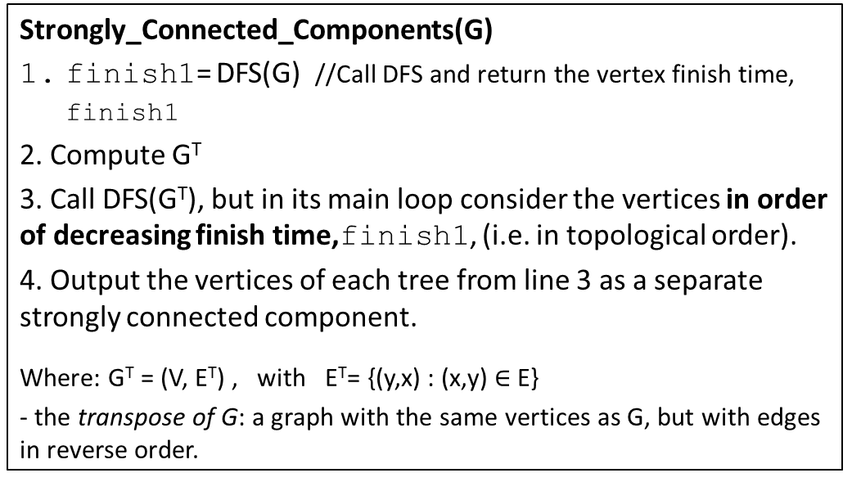
Strongly Connected Components in a Directed Graph
Strongly_Connected_Components(G)
finish1= DFS(G) //Call DFS and return the vertex finish time, finish1
2. Compute G^{T}
3. Call DFS(G^{T}), but in its main loop consider the vertices in order of decreasing finish time,finish1, (i.e. in topological order).
4. Output the vertices of each tree from line 3 as a separate strongly connected component.
Where: G^{T} = (V, E^{T}) , with E^{T}= {(y,x) : (x,y) $∈$E}
- the transpose of G: a graph with the same vertices as G, but with edges in reverse order.
Visited vertex | Pred | Finish
Finished (reverse order):
(Every node that finishes is added at the front) Consider different list implementations (array/linked list), and the time complexity for them. Can you use a regular array of size N? Can you add every node that finishes at the END?
/
/
/
/
/
/
/
/
4
6
2
1
4
6
2
1
3
5
0
3
5
0
/
/
/
/
/
/

Slide 35
Applications of Strongly Connected Components (SCC)
Simplify graph: collapse every SCC in one node
From stackoverflow (https://stackoverflow.com/questions/11212676/what-are-strongly-connected-components-used-for)
Model checking - “model checking is applied widely in the industry - especially for proving correctness of hardware components.”
Vehicle routing applications – “A road network can be modeled as a directed graph, with vertices being intersections, and arcs being directed road segments or individual lanes. If the graph isn't Strongly Connected, then vehicles can get trapped in a certain part of the graph (i.e. they can get in, but not get out).”
From Wikipedia (https://en.wikipedia.org/wiki/Strongly_connected_component)
SCC “may be used to solve 2-satisfiability problems (systems of Boolean variables with constraints on the values of pairs of variables)”
From neo4j (https://neo4j.com/docs/graph-algorithms/current/labs-algorithms/strongly-connected-components/)
“In the analysis of powerful transnational corporations, SCC can be used to find the set of firms in which every member owns directly and/or indirectly owns shares in every other member. Although it has benefits, such as reducing transaction costs and increasing trust, this type of structure can weaken market competition.”
“SCC can be used to compute the connectivity of different network configurations when measuring routing performance in multi hop wireless networks”
“applications in cell methods for the numerical study of discrete dynamical systems” https://math.stackexchange.com/questions/32041/uses-of-strongly-connected-components

Slide 36
Extra Slides

Slide 37
C implementation for Adjacency Matrix –Undirected graph
void graphCreateAndWork() {
int N;
scanf("%d",&N);
int E[N][N];
for (int i = 0; i < N; i++)
for (int j = 0; j < N; j++) E[i][j] = 0;
// call graph function here, e.g.:
// addEdge(N,E,1,3);
}
int edgeExists(int N, int E[][N], int v1, int v2){
if (v1>=N || v1<0 || v2>=N || v2<0) return -1;
return E[v1][v2];
}
void addEdge(int N, int E[][N], int v1, int v2){
if (v1>=N || v1<0 || v2>=N || v2<0) return;
E[v1][v2] = 1;
E[v2][v1] = 1;
}
void removeEdge(int N, int E[][N], int v1, int v2){
if (v1>=N || v1<0 || v2>=N || v2<0) return;
E[v1][v2] = 0;
E[v2][v1] = 0;
}
Simple version where the graph is represented by only N and E.
 | 0 | 1 | 2 | 3 | 4 | 5 | 6 | 7
0 | 0 | 1 | 1 | 0 | 0 | 1 | 1 | 1
1 | 1 | 0 | 0 | 0 | 0 | 0 | 0 | 0
2 | 1 | 0 | 0 | 0 | 0 | 0 | 0 | 0
3 | 0 | 0 | 0 | 0 | 1 | 1 | 0 | 0
4 | 0 | 0 | 0 | 1 | 0 | 1 | 1 | 1
5 | 1 | 0 | 0 | 1 | 1 | 0 | 0 | 0
6 | 1 | 0 | 0 | 0 | 1 | 0 | 0 | 0
7 | 1 | 0 | 0 | 0 | 1 | 0 | 0 | 0
Remember that you cannot return, from a function, an array allocated on the stack (with [][]) . Function graphCreateAndWork must NOT return E.

Slide 38
DFS with time stamps
Next, DFS with ‘time stamps’ of when a node u was first discovered (d[u]) and the time when the algorithm finished processing that node (finish[u]).
The time stamps are needed for:
Topological sorting
Finding strongly connected components
edge labeling (to distinguish between forward and cross edges)
tree edge
backward edge
forward edge
cross edge
The following pseudo-code does not specify all the details of the implementation

Slide 39
Depth-First Search (DFS) (with time stamps) - CLRS
Node u will be:
- WHITE before time d[u],
- GRAY between d[u] and finish[u],
- BLACK after finish[u]
DFS(G)
For each vertex u of G
color[u] = WHITE
pred[u] = NIL
d[u] = -1
finish[u] = -1
time = 0
For (u=0;u<G.N;u++) //each vertex u of G
If color[u] == WHITE // u is in undiscovered
DFS_visit(G, u ,&time, color, pred, d, finish)
// Search graph G starting from vertex u. u must be WHITE
DFS_visit(G,int u, int* time, ColType*color, int* pred, int* d, int* finish)
(*time) = (*time) + 1
d[u] = time // time when u was discovered
color[u] = GRAY
For each v adjacent to u // assume increasing order
If color[v]==WHITE // if color[v]==GRAY=>cycle found
pred[v] = u
DFS_visit(G,v,…..)
color[u] = BLACK
(*time) = (*time) + 1 //no two time stamps are equal.
finish[u] = time
When coding you can use any convention to represent the colors: strings, chars(w/b/g), int (0,1,2), etc.
WHITE
GRAY
BLACK
d[u]
finish[u]
In the graph picture below, assume no answer means the initial values: NIL, -1,-1
Time complexity:
Representation | DFS | DFS-Visit(G,u)
Adj LIST | Θ(|V|+|E|) | Θ(neighbors of u)
Adj MATRIX | Θ(|V|²) | Θ(|V|)
Space complexity: O(V)
Visited vertex | Pred | Start | Finish
Discover
time
Finish time
pred
__ / __ / __
__ / __ / __
__ / __ / __
__ / __ / __
4
6
2
1
3
5
0
(See CLRS page 605 for step-by-step example.)
__ / __ / __
__ / __ / __
__ / __ / __

Slide 40
Worksheet
Convention:
start /end
pred
Run DFS on the graphs below. Visit neighbors of u in increasing order.
For each node, write the start and finish times and the predecessor.
Do edge classification as well.
Order from 1st to last | Visited vertex | Pred | Start | Finish
__ / __ / __
__ / __ / __
__ / __ / __
__ / __ / __
0
1
8
3
6
4
5
7
2
__ / __ / __
__ / __ / __
__ / __ / __
__ / __ / __
__ / __ / __
DFS(G) (note that 0 moved)
DFS(G):
Notes:
print

Slide 41
Edge Classification
Edge type for (u,v) | Color of v | Arrow color (my convention) | Comments
Tree | White |  | v is first discovered
Backward | Gray |  | There is a cycle
Forward | Black |  | Shortcut. v is a descendant of u v started after u started
Cross | Black |  | v is not a descendant of u v started before u started
cross
cross
v started and finished BEFORE u started
fwd
bkwd
v started and finished AFTER u started
The edge classification depends on the order in which vertices are discovered, which depends on the order by which neighbors are visited.
4
6
2
1
4
6
2
1
3
5
0
3
5
0
DFS(G,0): 0, 2, 1, 5, 3, 6, 4
Visit neighbors of 3 in order: 6 and then 4
DFS(G,0): 0, 1, 2, 5, 3, 4, 6
Visit neighbors in increasing order.

Slide 42
Edge Classification for Undirected Graphs
An undirected graph will only have:
Tree edges
Back edges
As there is no direction on the edges (can go both ways), what could be a forward or a cross edge will already have been explored in the other direction, as either a backward or a tree edge.
Forward (u,v) => backward (v,u)
Cross (u,v) => tree (v,u)

Slide 43
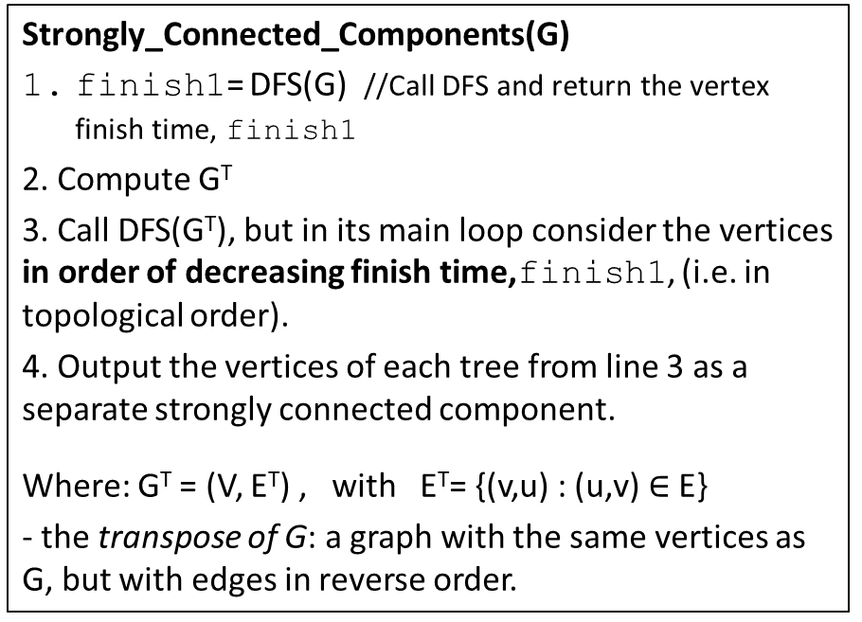
Strongly Connected Components in a Directed Graph
Strongly_Connected_Components(G)
finish1= DFS(G) //Call DFS and return the vertex finish time, finish1
2. Compute G^{T}
3. Call DFS(G^{T}), but in its main loop consider the vertices in order of decreasing finish time,finish1, (i.e. in topological order).
4. Output the vertices of each tree from line 3 as a separate strongly connected component.
Where: G^{T} = (V, E^{T}) , with E^{T}= {(v,u) : (u,v) $∈$E}
- the transpose of G: a graph with the same vertices as G, but with edges in reverse order.
Visited vertex | Pred | Start | Finish
__ / __ / __
__ / __ / __
__ / __ / __
__ / __ / __
__ / __ / __
__ / __ / __
__ / __ / __
__ / __ / __
4
6
2
1
4
6
2
1
3
5
0
3
5
0
__ / __ / __
__ / __ / __
__ / __ / __
__ / __ / __
__ / __ / __
__ / __ / __

Slide 44
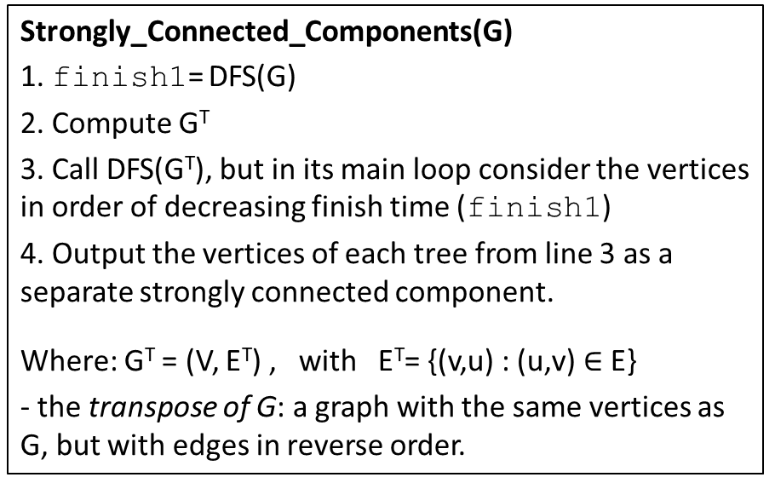
Strongly Connected Components in a Directed Graph Worksheet 2
Strongly_Connected_Components(G)
1. finish1= DFS(G)
2. Compute G^{T}
3. Call DFS(G^{T}), but in its main loop consider the vertices in order of decreasing finish time (finish1)
4. Output the vertices of each tree from line 3 as a separate strongly connected component.
Where: G^{T} = (V, E^{T}) , with E^{T}= {(v,u) : (u,v) $∈$E}
- the transpose of G: a graph with the same vertices as G, but with edges in reverse order.
Visited vertex | Start | Finish | Pred
__ /___
___ /___
___ /___
___ /___
__ /___
___ /___
___ /___
___ /___
6
1
2
3
6
1
2
3
4
5
0
4
5
0
___ /___
___ /___
___ /___
___ /___
___ /___
___ /___

Slide 45
Graph Traversal - Practice
BFS :
0
1
2
3
0
1
2
3
7
4
5
6
7
4
5
6
DFS :
0
1
2
3
0
1
2
3
7
4
5
6
7
4
5
6

Slide 46
Graph Traversal
For both DFS and BFS the resulting trees depend on the order in which neighbors are visited.
BFS traversal examples:
0
1
2
3
0
1
2
3
7
4
5
6
7
4
5
6
DFS traversal examples.
0
1
2
3
0
1
2
3
7
4
5
6
7
4
5
6

Slide 47
DFS Practice
Try various directions for arrows.
0
1
2
3
4
5
6

Slide 48
Extra Material – Not required DFS – Non-Recursive
Sedgewick , Figure 5.34, page 244
Use a stack instead of recursion
Visit the nodes in the same order as the recursive version.
Put nodes on the stack in reverse order
Mark node as visited when you start processing them from the stack, not when you put them on the stack
2 versions based on what they put on the stack:
only the vertex
the vertex and a node reference in the adjacency list for that vertex
Visit the nodes in different order, but still depth-first.
0
1
2
3
4
5
6

